Slide 1
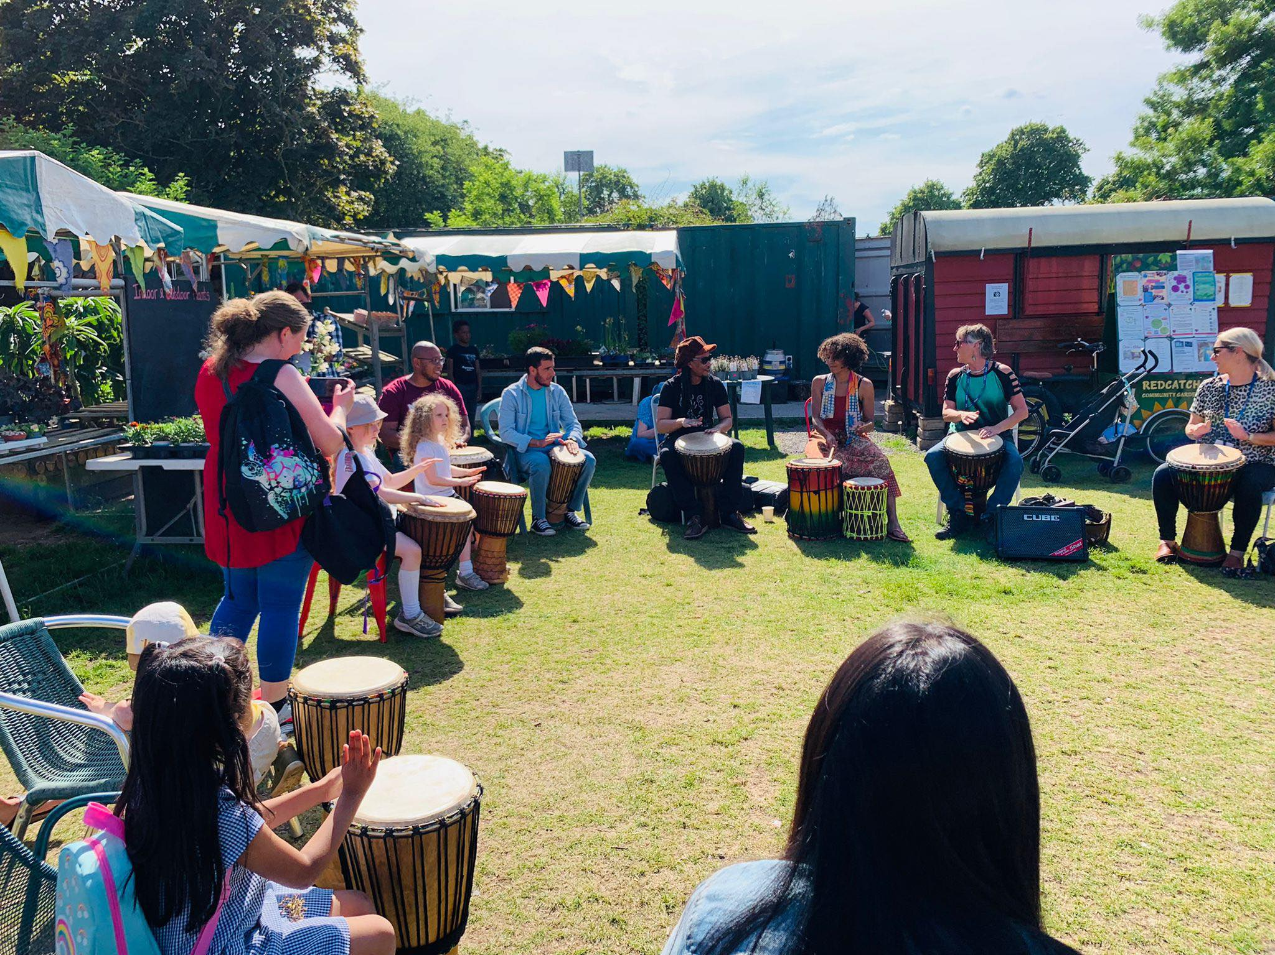

Creating Spaces of Welcome
Soo dhawoow
Bi xêr bî
Khosh Armadid
خوش آمدی
Ahlan Bik أهلا بك
أهلا بك
ښه راغلاست
Merhaba

Slide 2
OUR VISION AND MISSION
VISION
Refugees and asylum seekers feel welcome, valued and confident to celebrate and share their culture, skills and knowledge in their local community and beyond.
MISSION
Bristol Refugee Festival supports and facilitates newly arrived and settled communities to come together in celebration of inclusion and diversity through a year-round programme of events, with an annual cross art-form Festival at its core.

Slide 3
Creating Spaces of welcome workshop
In Oct 2022 Bristol Refugee Festival held a collaborative workshop to discuss how to create a network of community spaces across Bristol, where refugees and asylum seekers feel welcome and confident to participate and share their skills, knowledge and culture.
The workshop included speakers, activities and interactive discussion. We asked:
What is a welcoming space?
What are barriers to participation?
How do people share skills, knowledge and culture?
What are the next steps?

Slide 4
Why create spaces of welcome?
Remember what our community hubs are for…
Community spaces exist to provide a point of contact for all members of the community, to make them feel at home and to meet their needs:
Practical: such as accessing the internet, printing, job searches, signposting to other service providers
Cultural: for example learning a new language or skill, access to education, community gardening
Social: such as reducing loneliness, building relationships through connection, activities or volunteering opportunities, enhancing quality of life
We want to create welcoming spaces so that…
All community members feel comfortable
Everyone feels able to participate – regardless of age, background, ability
Everyone is able to contribute to their community by sharing skills, knowledge, culture
Community members can create a shared sense of belonging by connecting and building relationships
Vulnerable community members have the help and support they need

Slide 5
UNFRIENDLY GREETING
Unsmiling, unhelpful, hostile body language, lack of attention, little effort to understand, needs unmet, lack of follow-up
IGNORANCE
Insulting language, arrogance towards others, making assumptions, lack of cultural understanding, feeling out of place, not being heard
DOES NOT REFLECT DIFFERENT COMMUNITIES
Cultural difference and religion not considered or respected, lack of culturally appropriate foods, child unfriendly, signs in one language only
DIFFICULT ENVIRONMENT
Does not reflect differing needs and abilities - location, accessibility, lacking amenities, financial barriers, unnecessary bureaucracy, no effort to overcome language barriers
NO OPPORTUNITY FOR INCLUSION
Such as ways to share, open groups, points of contact
What makes a space feel unwelcoming?

Slide 6
VISIBLE, PERSONAL WELCOME
Smile, verbal greeting, friendly body language, taking time to listen, making effort to meet needs, hospitality provided
WARMTH
Laughter, humour; it’s OK to make mistakes - interactions and relationships are a two-way experience!
CLARITY & ACCESSIBILITY
Clear signposting, information in a variety of languages, child- and disability-friendly
SKILL & CULTURE SHARING
Self development and two-way sharing opportunities, activities for different interests and abilities, resources e.g. dictionaries, books, toys
CELEBRATING DIVERSITY
Creating a sense of familiarity and belonging through colour, tablecloths, music, decor
What makes a space feel welcoming?

Slide 7
icebreakers and activities
At the workshop, these were the ice breakers/activities we did as a group. They worked well and got people thinking!
Each participant is given a coloured shape
They must find another person with the same shape
Encourages movement round a space, interaction, conversation
Provides a shared mission and opportunity for cooperation
Instructions are given in a language of choice
Participants attempt to complete the task based on any verbal instructions they might understand, body language, gestures, following others etc.
A fun, potentially chaotic, non-verbal game…
…that provides powerful insight and active experience of a language barrier
It also enables cultural sharing of different languages
Participants anonymously share a little-known fact about themselves with a group
Group members try to match the facts with the right participant
Helps participants to get to know each other
Encourages conversation
Provokes thought around learning new things about people and a reminder that individuals’ backgrounds are often interesting and surprising

Slide 8
Top tips for participation!
Language – speak slowly, use translation apps, dictionaries, visual aids. Design activities that don’t need language
Ask people what they need – be open and take time, break things down.
Show people they are valued – use active listening, encourage others to speak, provide opportunities to contribute in a variety of ways, thank people for their contribution regardless of how small
Build trust and confidence – remember and use people’s names, include all family members including children in conversations and activities, offer opportunities for people to make contributions that may lead to opportunities for skill sharing
Ensure you have a clear joined up offer – be aware and honest about what you can offer, ensure that messaging is consistent

Slide 9
Top tips for SKILLS, KNOWLEDGE AND
CULTURE SHARING!
Getting to know each other breaks down barriers
Help individuals feel involved, accepted, welcomed and part of their community.
Our community spaces can create opportunities for sharing. How?
Invite people to celebrate an important cultural date together
Invite people to hold/join creative workshops (think about language)
Cook food together
Find out what people and their families are interested in.
Start a language exchange

Slide 10
What to do now!
Next steps for creating spaces of welcome
INCLUSION – INTERACTION – INTEGRATION
Tip 1: Evaluate your welcome and interactions
Actions: Positive attitude and smiles, welcome signs in a variety of languages, free tea/water station, clear signposting to services
Tip 2: Make your space visually reflect the diversity of your community
Actions: Colourful tablecloths, menu offerings, signage, pictures and photos
Tip 3: Create opportunities for participation and two-way sharing
Actions: Language exchanges, food and culture sharing events and workshops, create accessible pathways to volunteering and paid employment
Tip 4: Get everyone on board!
Actions: Education and training for staff (e.g. cultural awareness and asylum process), support structures that ensure greater diversity of staff and decision makers

Slide 11
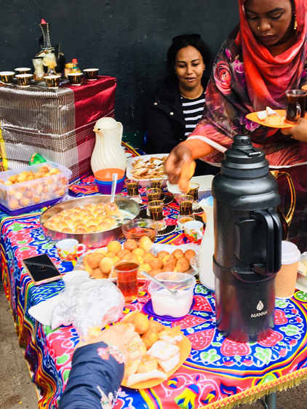
Share Your Successes!
Email or tag us on social media with steps you’ve taken – include photos if you like. We want to motivate each other and keep the conversation going!
Twitter: RefugeeFestBRL
Insta: @bristolrefugeefestival
Facebook: BristolRefugeeFestival
Useful Links:
Asylum Process - www.righttoremain.org.uk
---
Bridges for Communities (cultural awareness training) - www.bridgesforcommunities.com/programmes/training
---
Experts By Experience (recruiting people with lived experience) - www.ebeemployment.org.uk

